Slide 1
Chapter 1 Introduction to Distributed Systems

Slide 2

A distributed system is a collection of independent computers that appears to its users as a single coherent system

Slide 3
Goals of Distributed Systems
Inherently Developed Applications
High performance
Low response time
Scalability
Flexibility
Reliability
Availability
Security
Better price performance ratio

Slide 4
Models
Mini Computer (ARPAnet)
Workstation
Workstation Server
Processor pool
Hybrid

Slide 5
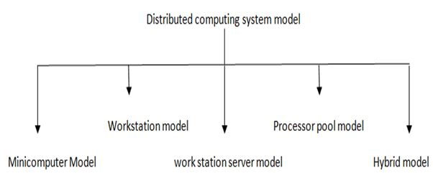

Slide 6
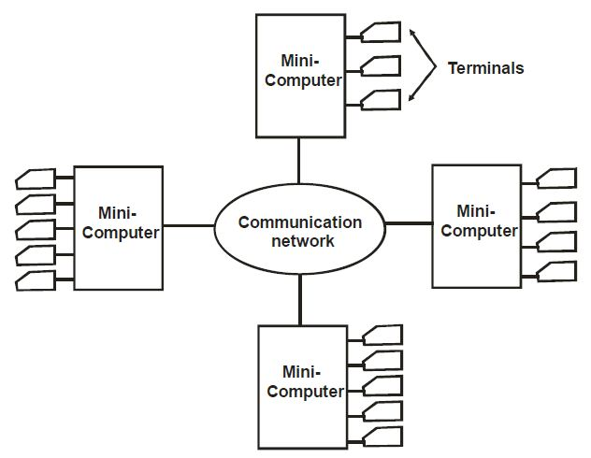
Mini Computer

Slide 7
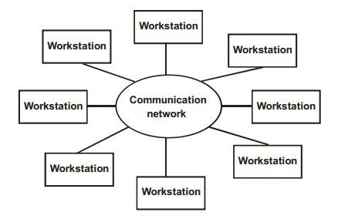
Workstation

Slide 8
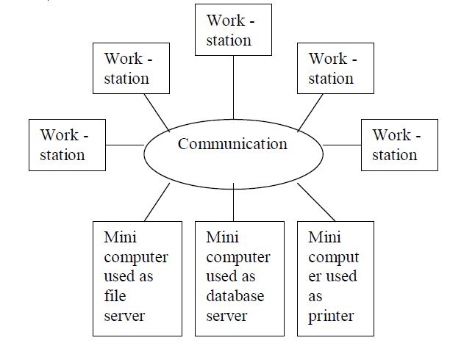
Workstation Server

Slide 9
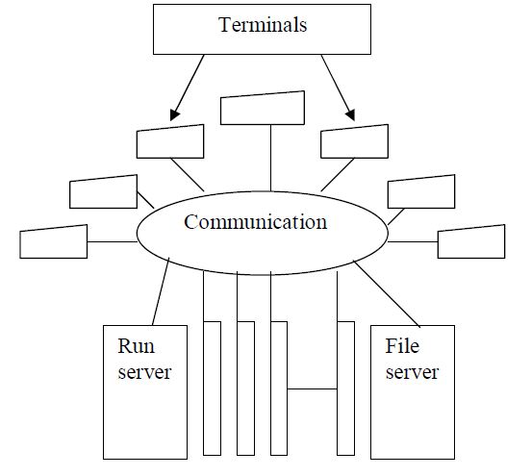
Processor Pool

Slide 10
HYBRID MODEL

Slide 11
HARDWARE CONCEPTS OF DISTRIBUTED SYSTEMS

Slide 12
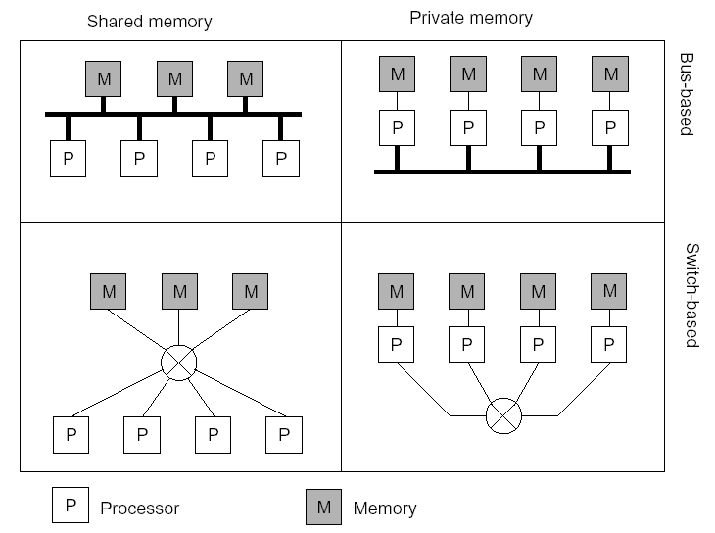
Multiprocessors and Multicomputers
Distinguishing features:
Private versus shared memory
Bus versus switched interconnection

Slide 13
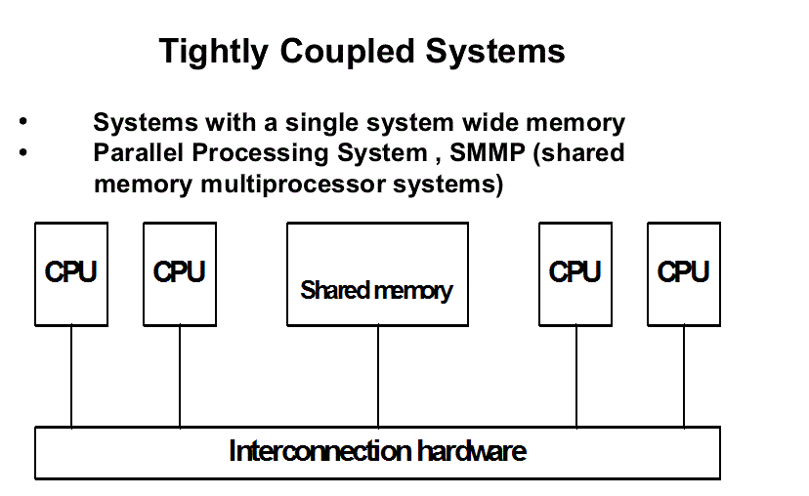
Tightly Coupled

Slide 14
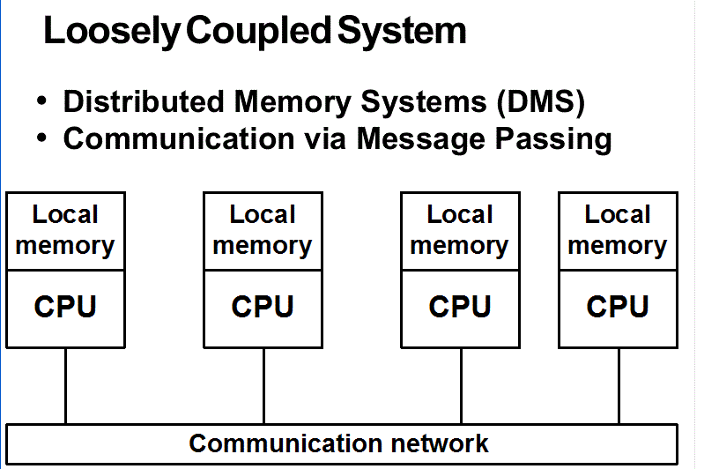
Loosely Coupled

Slide 15
SOFTWARE CONCEPTS OF DISTRIBUTED SYSTEMS
NOS
DOS
MIDDLEWARE

Slide 16
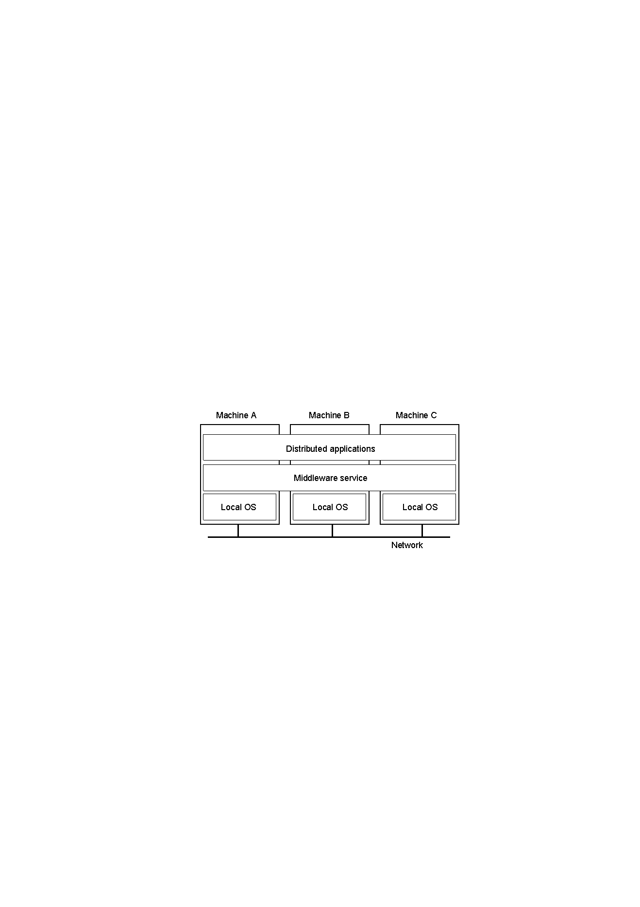
DOS

Slide 17
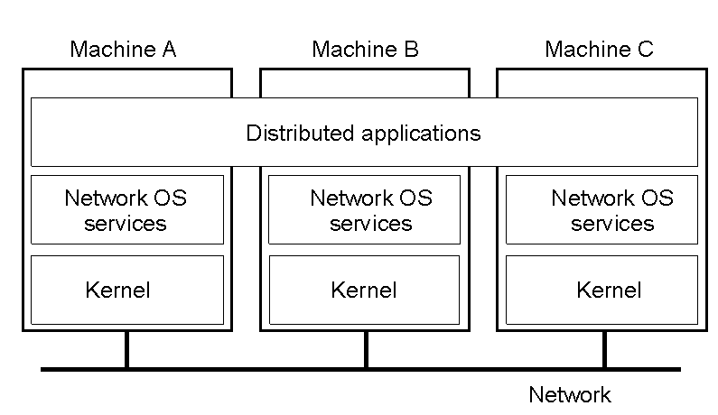
NOS

Slide 18

DCE

Slide 19
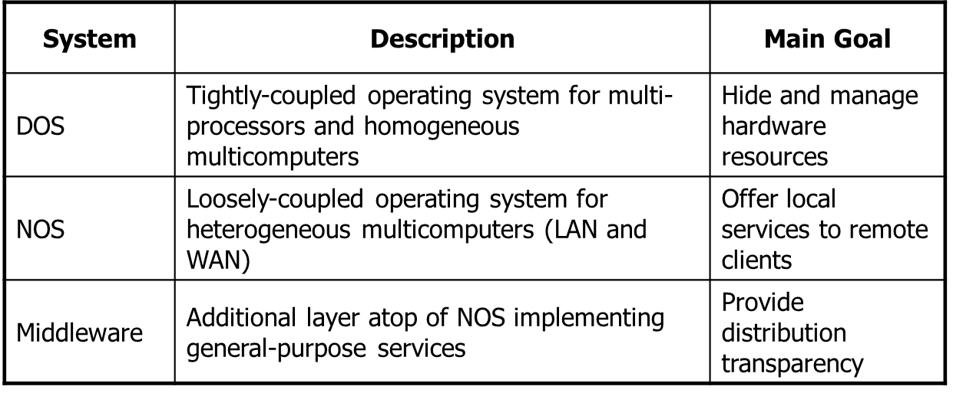
DOS NOS DCE

Slide 20
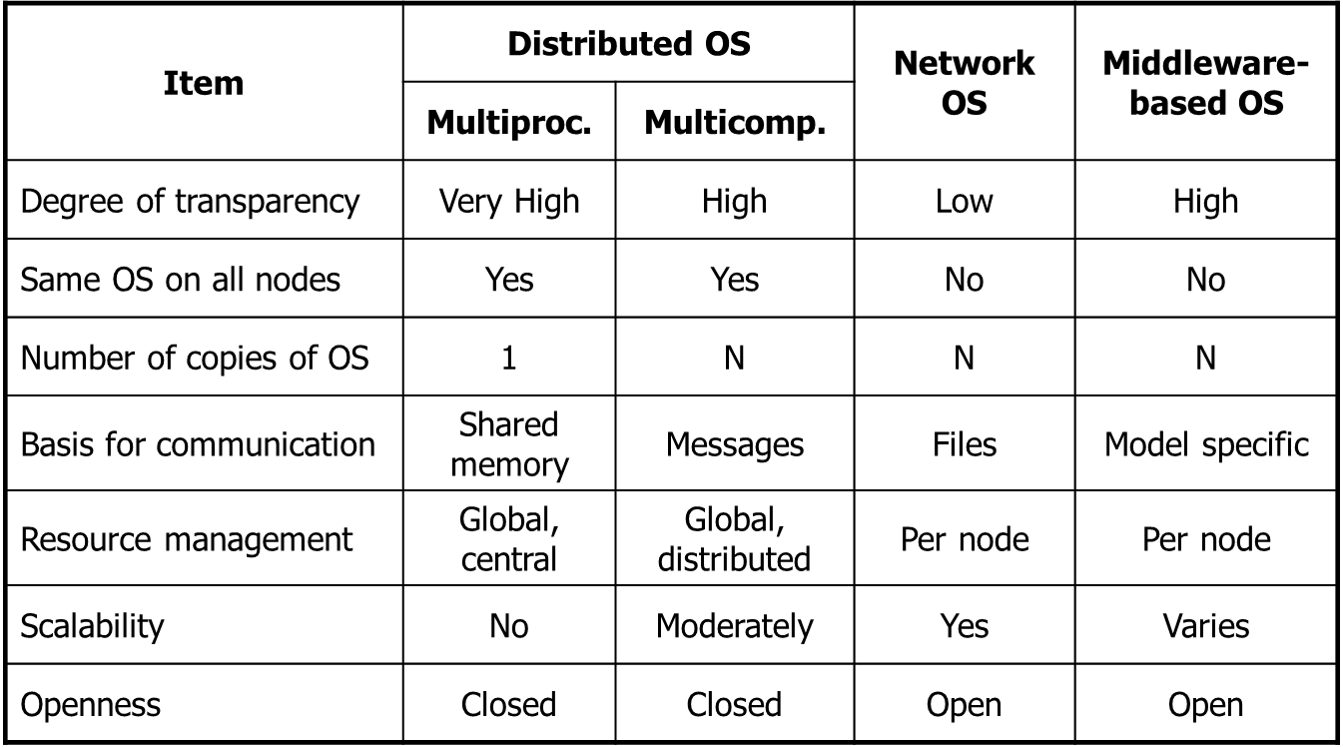
DOS vs NOS vs DCE

Slide 21
MODELS OF DCE
Thread package
Rpc
Distributed time services
Naming
DFS
Distributed Security

Slide 22
Design Issues In Distributed System
Transparency
Heterogeneity
Security
Reliability
Flexibility
Scalability
Performance
Emulation of existing software

Slide 23
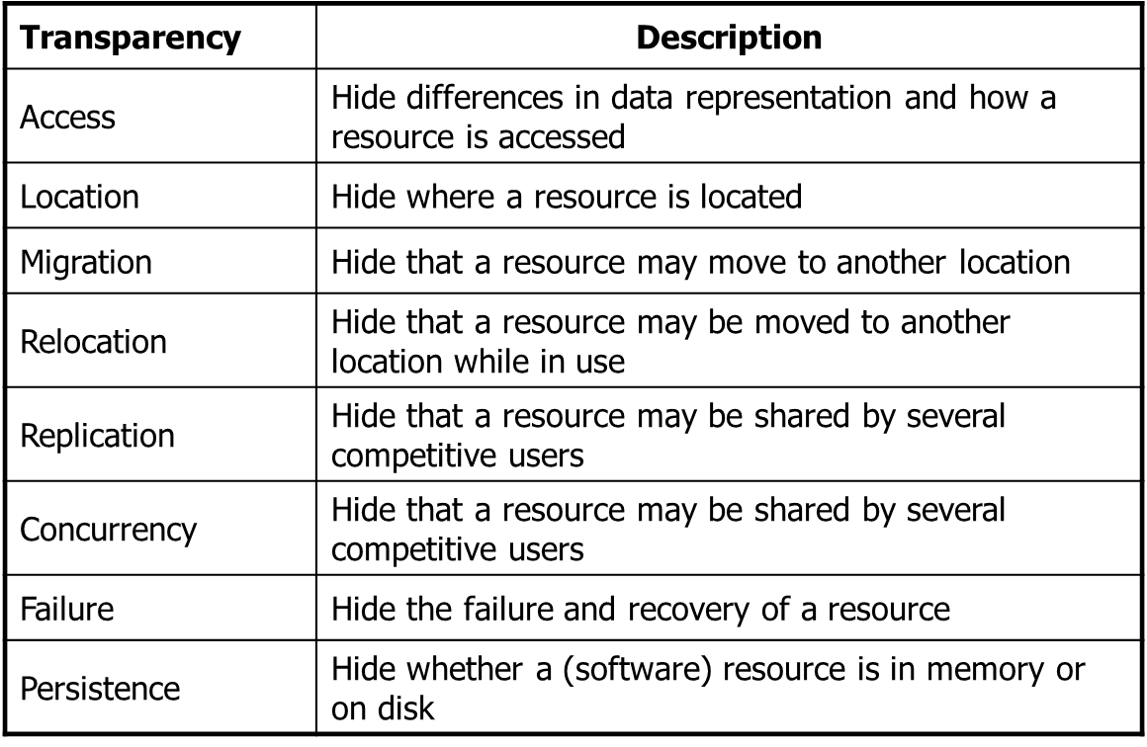
Transparency

Slide 24
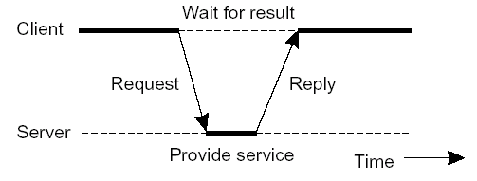
Basic Client–Server Model
Server: a process implementing a specific service (e.g.: a file
system service; a database service)
– Client: a process thar requests a service from a server by sending a
request and subsequently waiting for the server reply
01 – 23 Introduction/1.5 Client–Server Model

Slide 25
Multitier Architectures
• A server may sometimes also act as a client (three-tiered architecture)

Slide 26
Failure
Types of Failures in Distributed Systems:
Crash Failure:
A process or node stops working and does not recover.
Example: A server powering down unexpectedly.
Omission Failure:
A process or communication channel fails to send or receive a message.
Subtypes:
Send Omission: A process fails to send a message.
Receive Omission: A process fails to receive a message.

Slide 27
Failures
Importance of Handling Failures
Failure management is critical to ensure:
Reliability: The system functions correctly despite failures.
Fault Tolerance: The system continues to operate, even when some components fail.
Recovery: The system can detect and recover from failures effectively.

Slide 28
Timing Failures:
A component takes longer than expected to complete an operation, violating time constraints.
Example: A process fails to respond within the required time window in a real-time system.
Response Failures:
A component provides an incorrect response.
Subtypes:
Value Failure: The response is incorrect in value.
State Transition Failure: The system transitions to an incorrect state.
Byzantine Failures:
A component behaves arbitrarily or maliciously, sending incorrect or inconsistent
information to other components.
Example: A node sends conflicting messages to different parts of the system, causing confusion.

Slide 29
Resource Failures:
A system runs out of necessary resources such as memory, disk space, or CPU cycles,
affecting its operation.
Example: A database server crashing due to insufficient disk space.
Network Failure: Communication between components is disrupted due to issues such as packet loss, high latency, or partitioning of the network.

Slide 30
Key Characteristics of Distributed System Failures:
Partial Failures: Only some components fail, while others may continue functioning.
Uncertainty: It may be challenging to distinguish between a slow component and a failed one (e.g., a delayed response vs. no response).
Propagation: Failures can cascade if not handled properly, affecting the entire system.
Importance of Failure Handling:
To ensure reliability, distributed systems must include mechanisms for failure detection, fault tolerance, recovery, and redundancy to minimize the impact of failures and maintain system

Slide 31
Thank You!!!!

